Slide 1
INTELLIGENT INFRASTRUCTURE CATEGORISER
DONE BY
ARUNA
KAVYA
GEETHA
VAIBHAV VASANTH(MENTOR)

Slide 2
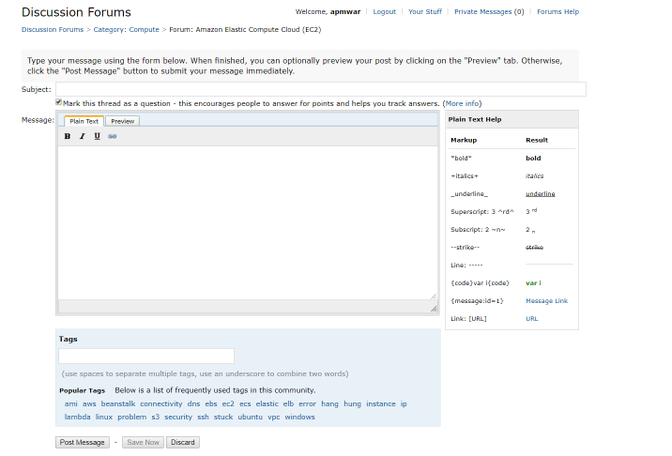

Slide 3
PROBLEM STATEMENT
AWS Services are growing at a very rapid pace where every quarter newer service is getting added. Even for similar use cases there are multiple services. Though it gives engineers lots of option, it sometimes creates a situation where an engineer is unaware of existing service.

Slide 4
STEPS INVOLVED
Web scraping
Cleaning the data
Building a Machine Learning Model
Building Flask Model
SVM
LOGISTIC REGRESSION

Slide 5
TF AND IDF
TF-Term Frequency
ITF-Inverse Term Frequency
TF=(Number of times term t appears in a document) / (Total number of terms in the document).
ITF=log_e(Total number of documents / Number of documents with term t in it).

Slide 6
CLEAN THE DATA
RUN THE ML MODEL
VALIDATING ACCURACY USING PAST DATA
RETRAIN MODEL AND SAVE
SCRAPE THE NEW DATA

Slide 7
Resume Scraping If error occurs
Scrape Data from all product forums
Implemented custom exception to automatically
CLEAN SCRAPED DATA
Retain crucial context(Like HTTP LINKS)
Remove useless symbols and code
Remove stop words/Product names
Grid CV
Tune parameters
and recall
In terms of accuracy
Select best mode
Train
ML
model
using

Slide 8
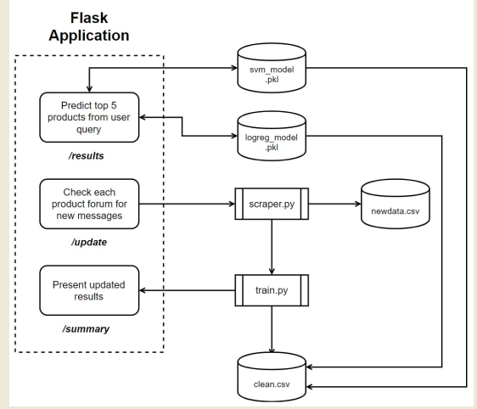

Slide 9
Machine Learning Model
1.Precision
2.Recall
3.f1 score
4.Support

Slide 10
FUTURE SCOPE
Production similarity
Training the neural network
Extending this idea to all forum products
Getting more data and make the model more efficient
Deploying model through AWS Sage maker

Slide 11
THANK YOU😊

Slide 12


